Slide 1
Bayesian Optimisation for chemical reaction engineering
A data-driven way of exploring a mixed space
Ted Ladas, PhD Candidate at KCL | 20-Aug-2022

Slide 2
The main idea
- The aim of the internship: Explore Bayesian Optimisation in the field of Chemical Synthesis
- Many papers in the literature demonstrate how useful this algorithm can be
- The challenge is to include multi-level categorical features in the algorithm as well

Slide 3
Gaussian Process Regression
Weight all possible models

Slide 4
Gaussian Process Regression - basic idea
- Suppose we have the problem $f(x)=w^{⊤}x+ε$
- with data $D=\{(x_{1},y_{1}),(x_{2},y_{2}),…,(x_{n},y_{n})\}$
- We need $D→w→y^{new}$. The $w$ itself are not important
- What we really care about $P(y|x,D)=∫_{w}p(y|x,w)\frac{p(D|w)p(w)}{Z}dw$
- If we make the assumption that $p(w)∼N$ then $p(y|x,D)∼N(μ,Σ)$

Slide 5
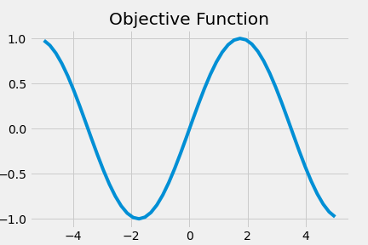
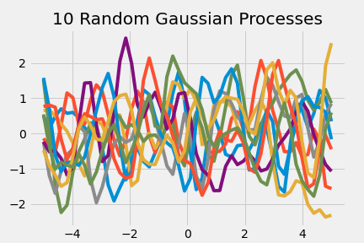
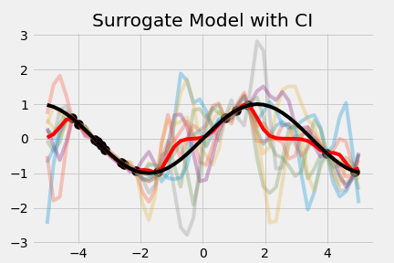
The Gaussian Process example
- We want to estimate the simple objective $f(x)=sin(x)$
- Assuming a Gaussian Prior we draw 10 Gaussian Processes
- Given some $x$ we can run the experiment and calculate $f(x)$
- With that data we can calculate $μ$ and $Σ$ of the posterior
$\overset{̂}{y}|D=N(K_{*}^{⊤}K^{-1}y,K_{**}-K_{*}^{⊤}K^{-1}K_{*})$, where $K$ some kernel

Slide 6
Bayesian Optimisation
A Sequential algorithm for optimisation

Slide 7
Bayesian Optimisation - basic idea
- Suppose we have the same black-box function $f(x)$
- Expensive Evaluation - Noise corrupted observations
- We don’t care anymore about $\overset{̂}{f}$ - We care about $\text{argmax}f(x)$
- We need a strategy to select $x^{next}$
1. Initial sample of input.
2. Evaluate the black box function $f(x)$
3. Train the Model - (Gaussian Process, Response Surface, Trees, Bayesian Neural Network, etc)
4. Calculate the acquisition function $α(x)$
5. Identify next step $\text{argmax}α(x)$
6. Goto step 2, until budget is exhausted

Slide 8
Bayesian Optimisation - basic idea
- The $α(x)$ balances exploration and exploitation.
- In a simple example $α(x)=f(x)-k⋅\text{sd}(f(x))$
- Small $k$ $→$ $α(x)≈f(x)$ $→$ Local Optimisation (exploitation)
- Large $k$ $→$ $α(x)≈\text{sd}(f(x))$ $→$ Global Optimisation (exploration)
- Then the query strategy is simply: $x_{next}=\text{query}(M,D)={\text{argmax}}_{x∈X}α(x;M,D)$

Slide 9
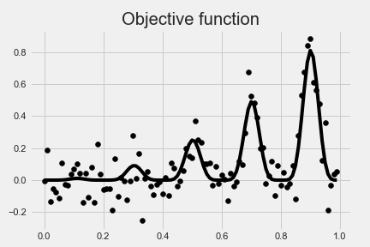
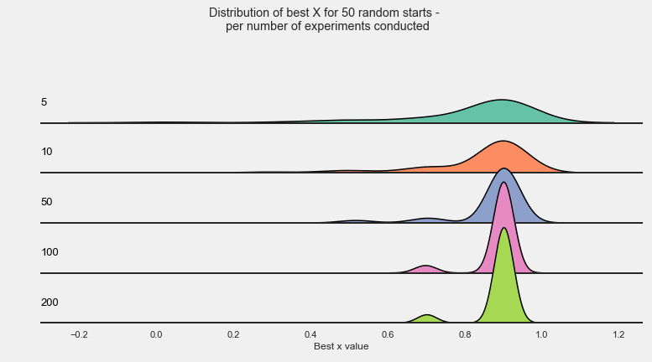
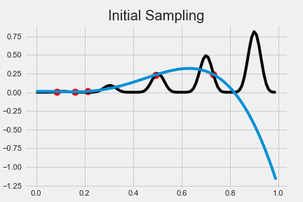
Bayesian Optimisation - example
- We have the objective $f(x)=x^{2}sin(5πx)^{6}$
- We obtain a random sample of $5$ input points

Slide 10
Demo
Web Application

Slide 11
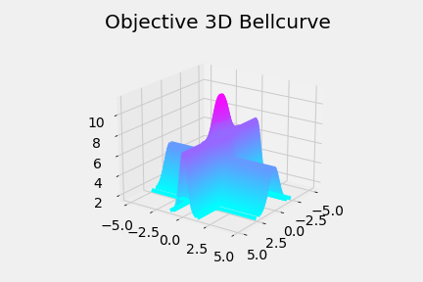
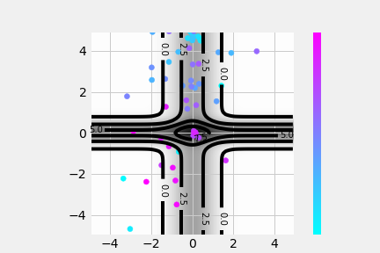
Bayesian Optimisation System
- 3d Example of a known function with steep local optima
- Objective $f(x_{1},x_{2})=4exp(-x_{1}^{2})+6exp(-4x_{2}^{2})maxf=f(0,0)=10$
- The algorithm start of randomly
- After 50 experiments it finds the global maximum

Slide 12
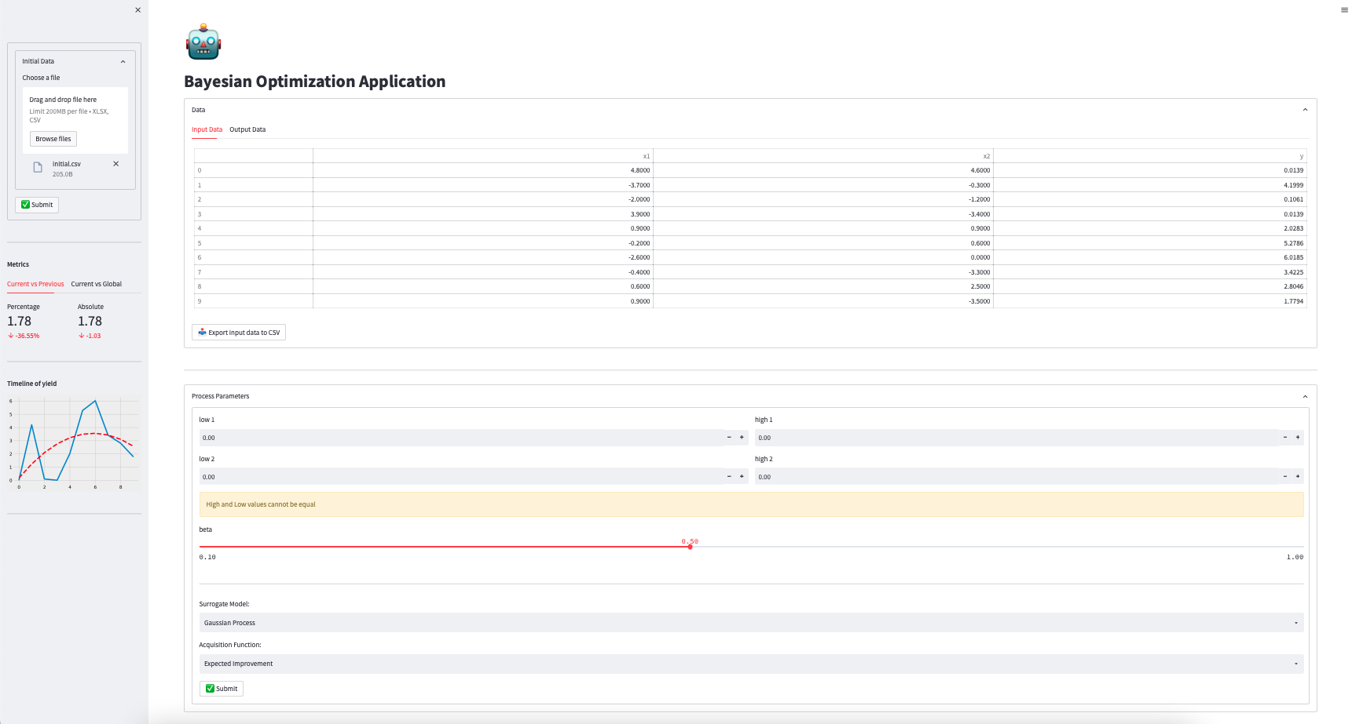

Slide 13
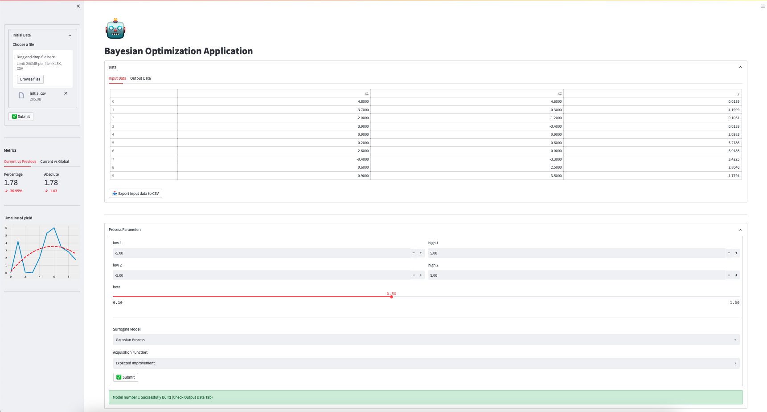

Slide 14
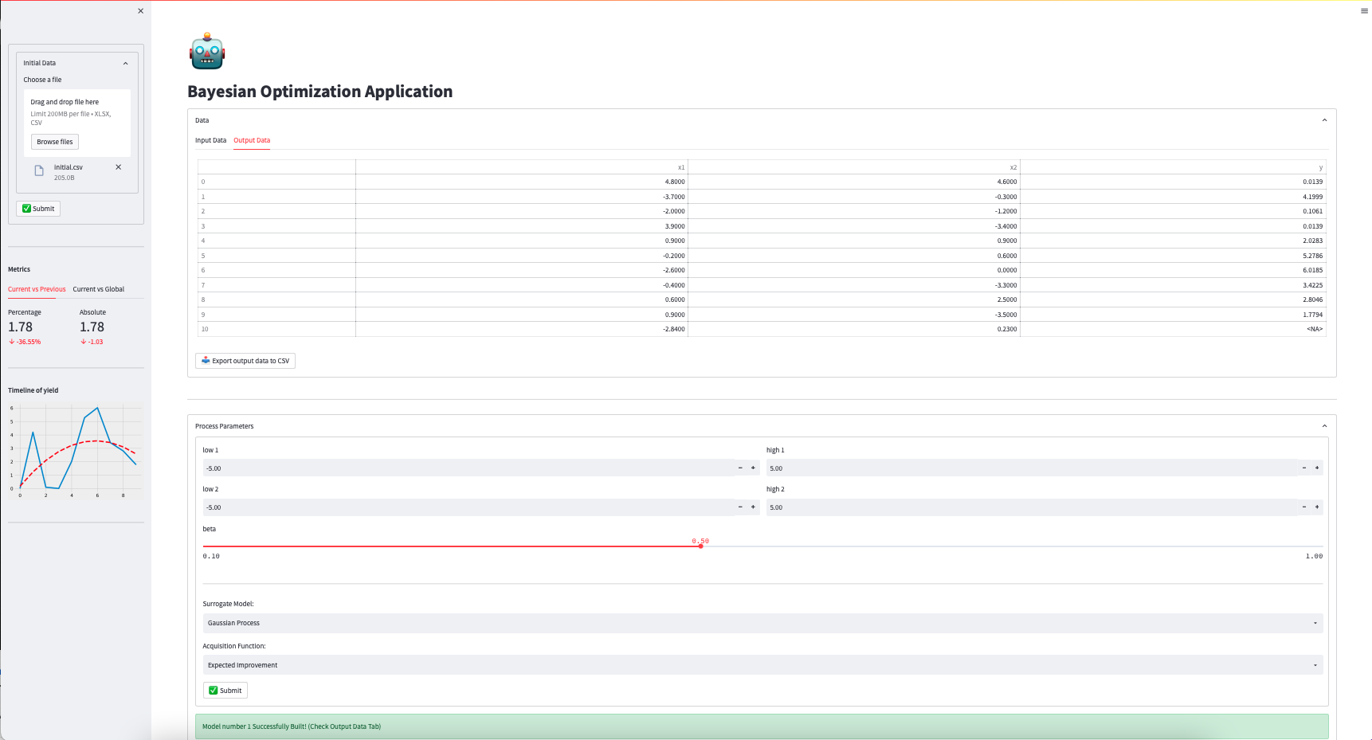

Slide 15
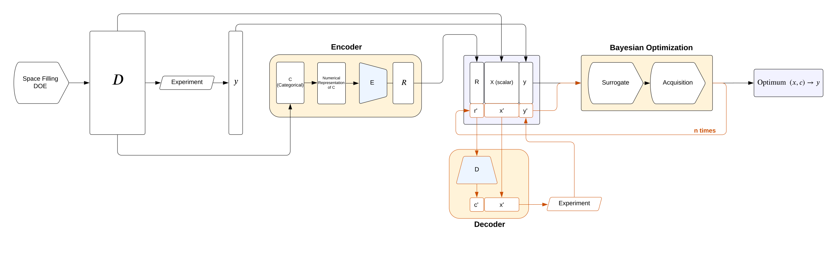
Bayesian Optimisation System

Slide 16
Variational Auto Encoders
How to include categorical data

Slide 17
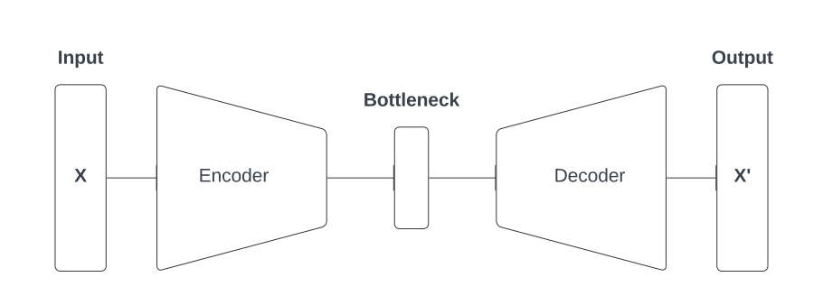
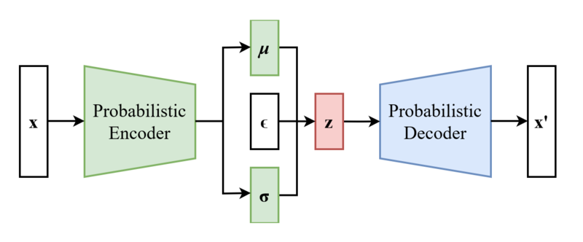
Variational Auto-Encoders
- Auto-encoders are Neural Network architectures
- The network is a function $f(x)≈x$
- A generalisation of auto-encoders are variational auto-encoders
- $z=μ+σ×ε,ε∼N(0,1)$, hence $z∼N(μ,σ^{2})$

Slide 18
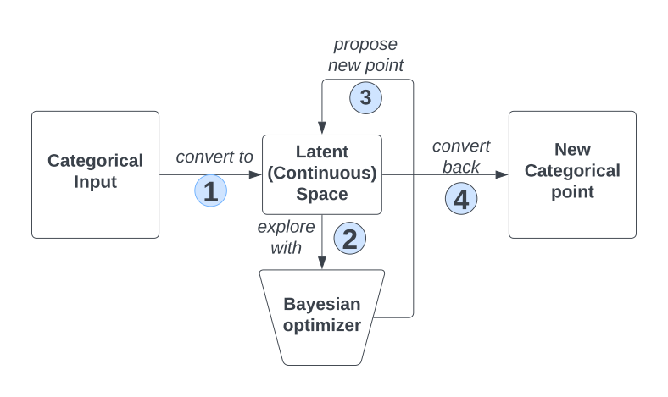
Variational Auto-Encoders utility
- Bayesian Optimisation needs numerical inputs
- Learn a numeric latent representation of the categorical variables
- Perform a step in that space through Bayesian Optimisation
- Decode the new signal and run the experiment

Slide 19
Thank you
tladas@its.jnj.com / k20103629@kcl.ac.uk
30-Aug-2022

